Slide 1
Visualising DATA
Programming for Data Analytics
Andrew.Beatty@atu.ie

Slide 2
General Types of Visualizations:
Plot (chart): This is what matplotlib is good at
Table: We will be covering PANDAS next week
Graph: represents certain variables in comparison to each other.
Geospatial: On a map
Infographic: A combination of visuals and words that represent data.
Dashboards:

Slide 3
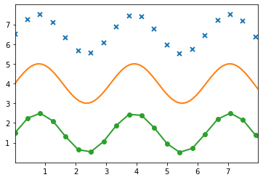
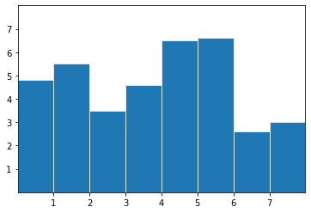
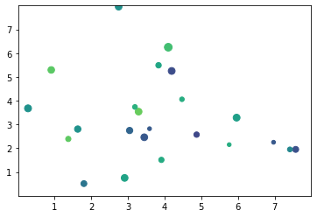
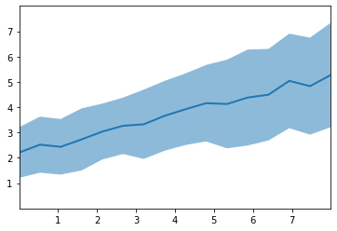
Types of plots
Box plot
Line Plot
Scatter plot
Line between plot

Slide 4
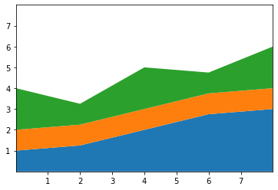
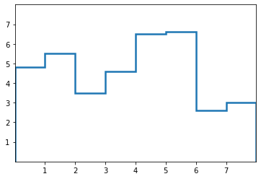
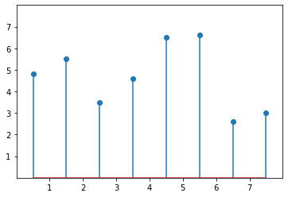
Types of plots
Stack plot
Stairs Plot
Stem plot

Slide 5
In other languages
D3.js: It is a front-end JavaScript library for producing dynamic, interactive data visualizations in web browsers. D3.js
ECharts: Echarts is based in JavaScript and ZRender, a lightweight canvas library.
And two I have never used
Vega: Vega uses JSON
deck.gl: It is part of Uber's open source visualization framework suite. deck.gl

Slide 7
Some principles
Set the context:
Why?
Know your audience(s):
Choose an effective visual:
Always have units and legend
Keep it simple:

Slide 8
Stand up and stretch
Next lecture I will be going into the matplotlib documentation in a bit more detail

